Slide 1
Indoor Positioning System (IPS)
Sarnava Konar
Mauricio Cisneros

Slide 2
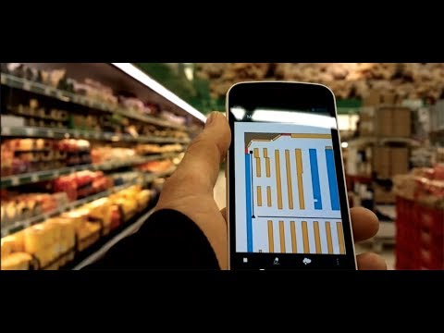
Introduction
An Indoor Positioning System determines the user's location while being inside a building.

Slide 3
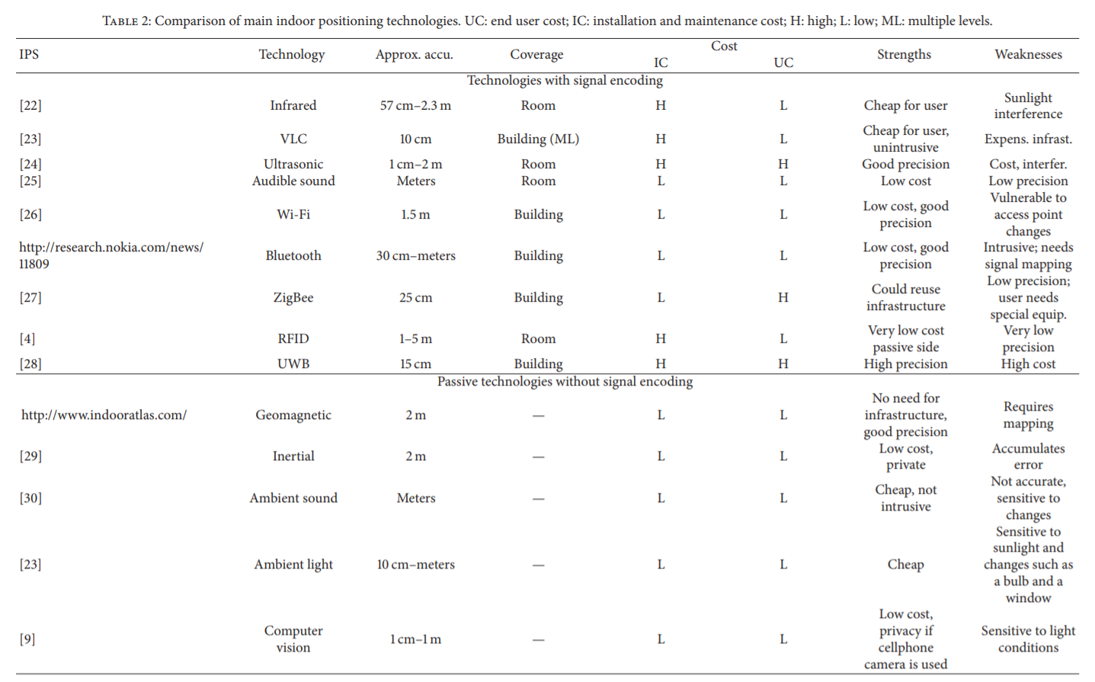
This can be achieved through different technologies:
Brena, R., et al. (2017). Evolution of Indoor Positioning Technologies: A Survey. Journal of Sensors.

Slide 4
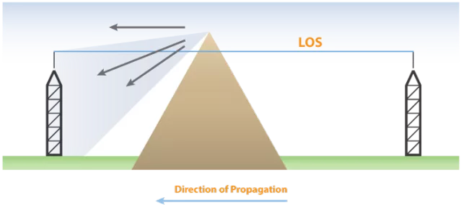
Justification
IPS is necessary as GPS does not work in indoor areas! But WHY? Since there is no line of sight!
So is Google Maps a waste!!?? Who saves us now?? IPS comes to our rescue!!

Slide 5



Use cases:
This system can be used in museums, shopping malls, hospitals, institutions etc. Firefighters can also use IPS during emergencies for navigating through indoor environments.

Slide 6
Software
Technologies used :
HTML5
CSS3
JavaScript
jQuery
Tools used :
Apache Cordova
Visual Studio 2017

Slide 7
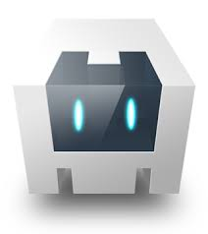
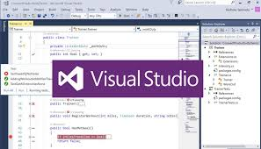
Apache Cordova : It is a mobile application development framework which helps develop cross platform mobile applications using standard technologies like HTML5, CSS3 and JavaScript.
Visual Studio 2017: It is an Integrated Development Environment (IDE) which enables programmers to develop computer programs, web apps and mobile apps.

Slide 8



HTML and CSS to show minimal UI (User Interface) to the users for better navigation through the app.
Evothings plugin for speaking to the Bluetooth Low Energy beacons.
JavaScript functions for giving users the coordinates of a place which finally leads them to give the Points of Interests (POI)

Slide 9

Now let’s go for a step by step tour to show you how the app Works!!

Slide 10
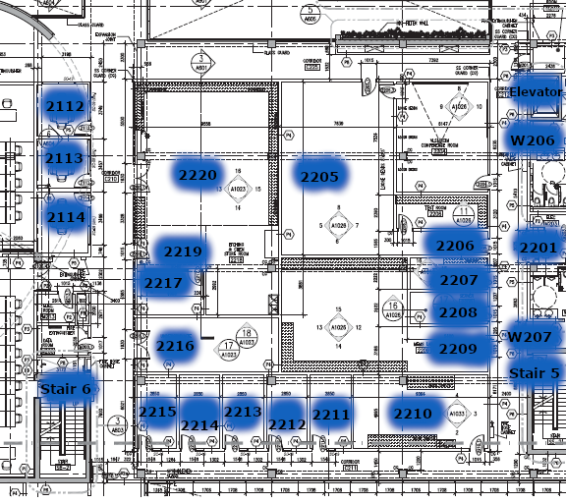
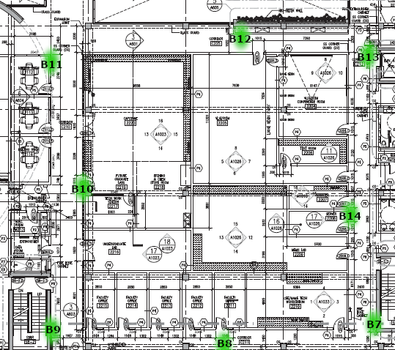
Mapping
Location for each room in the second floor of CEI.
8 beacons were mapped in the second floor.

Slide 11
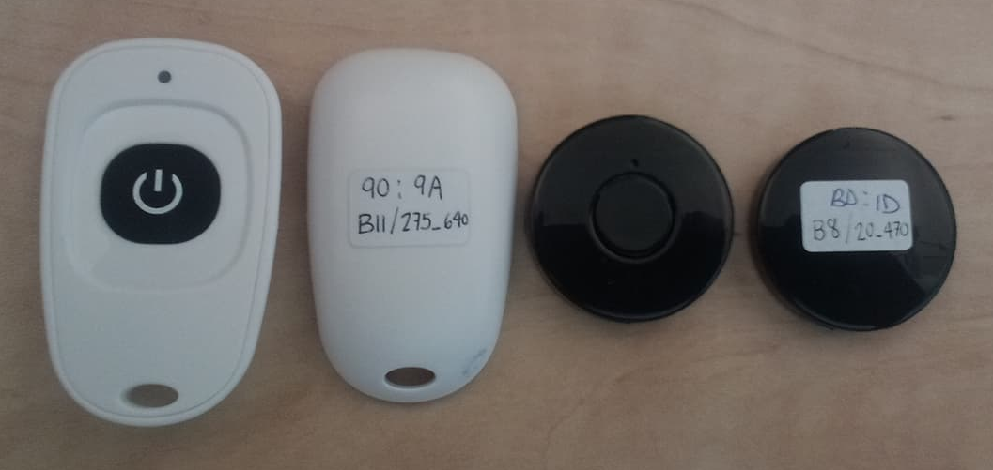
Hardware
Beacons based on the Texas Instruments Bluetooth Low Energy (BLE) CC2541 chip.
PC038
PC037

Slide 12
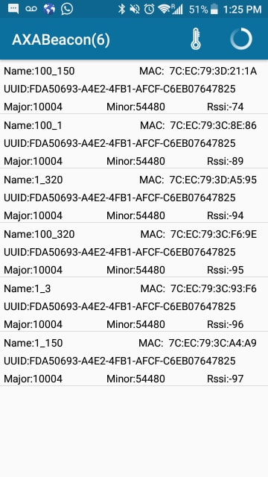
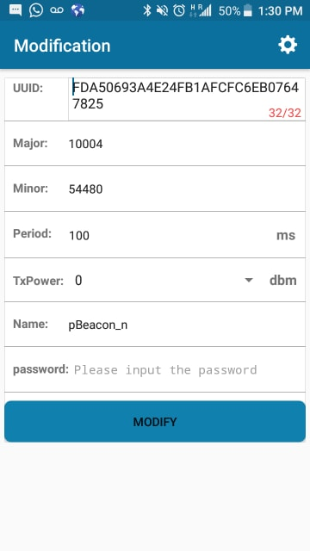
Programming beacons with AXABeacon

Slide 13
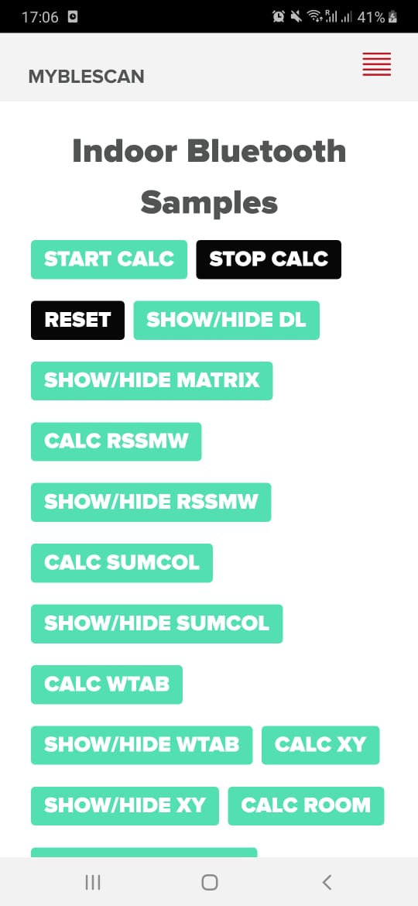
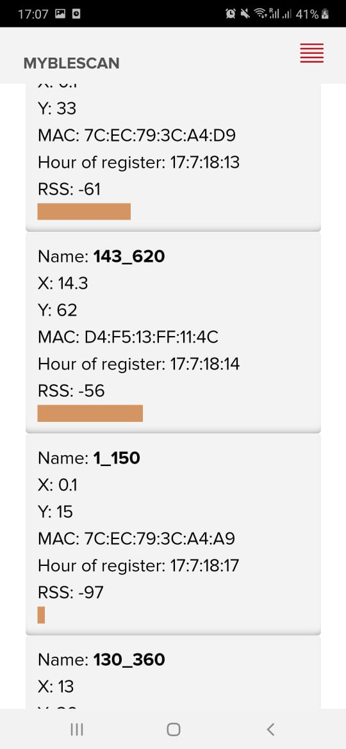
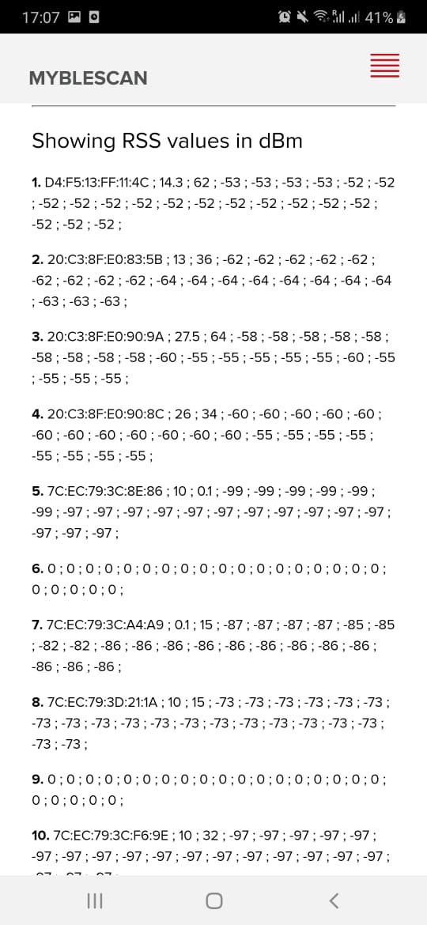
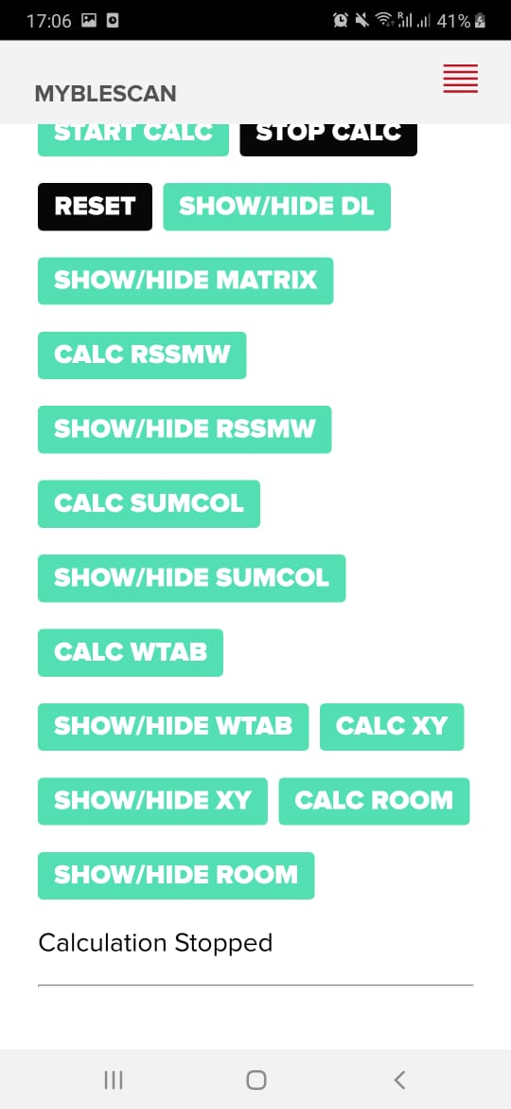
UI (User Interface) at various developmental stages
Commands available
Showing detected beacons
RSS values in dBm

Slide 14
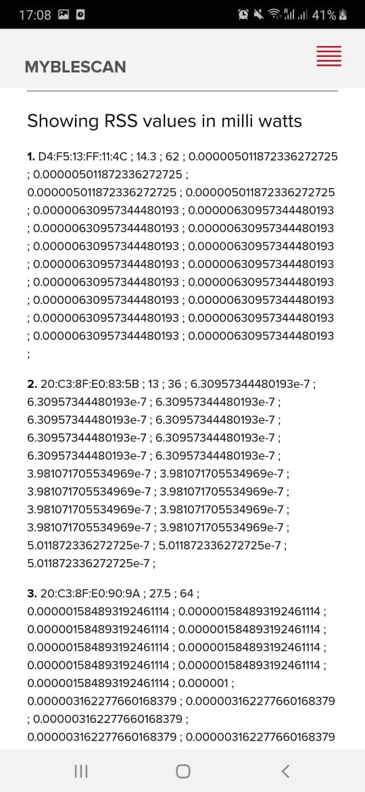
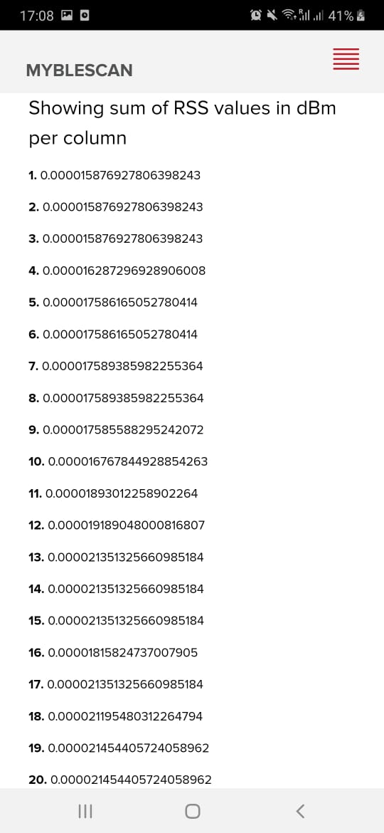
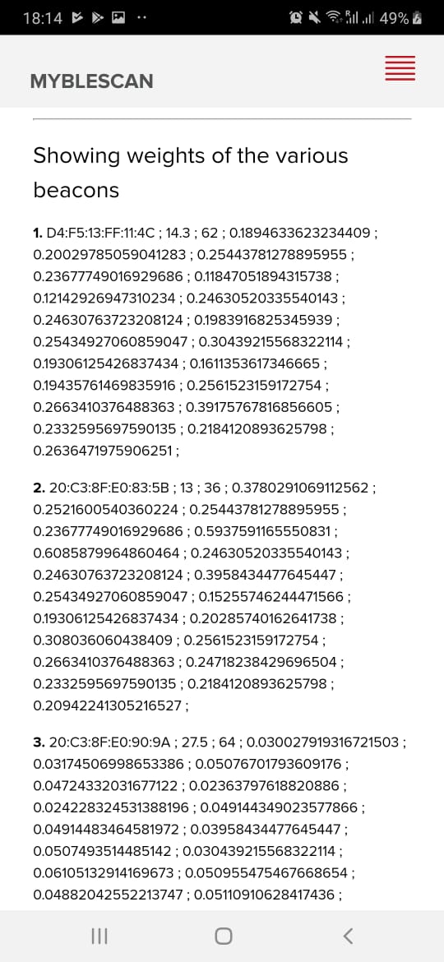
Continued from previous slide
RSS values in mW
RSS values in dBm per column
Weights of beacons

Slide 15
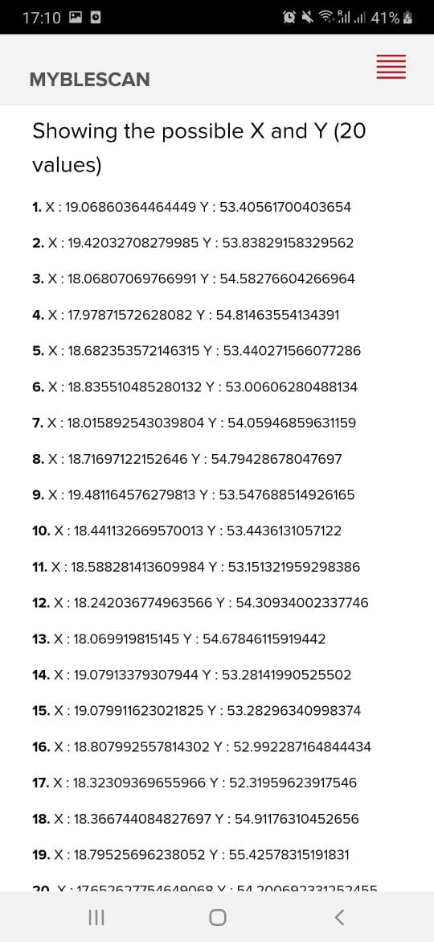
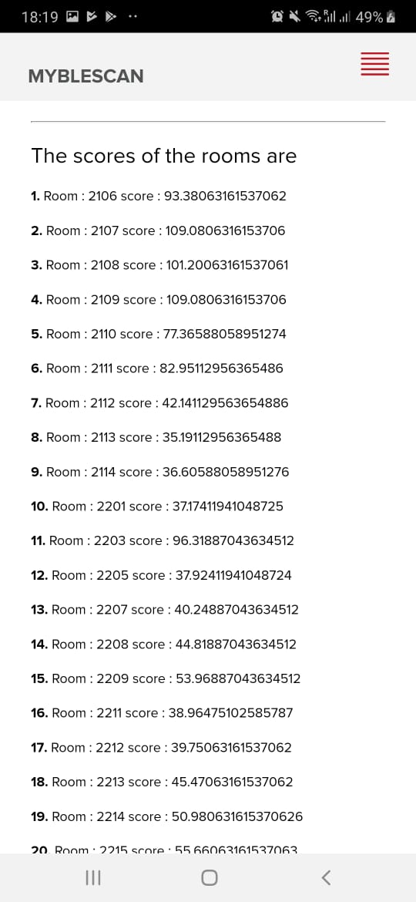
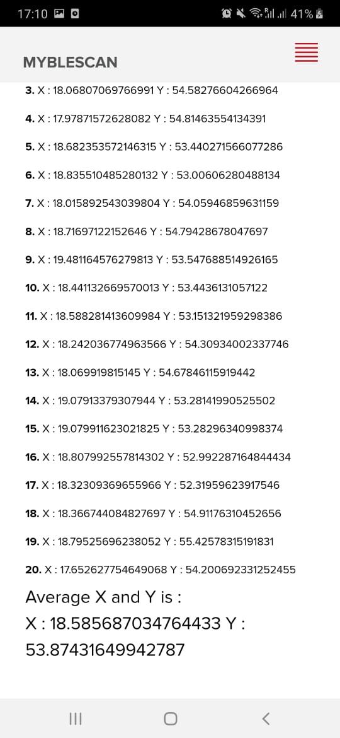
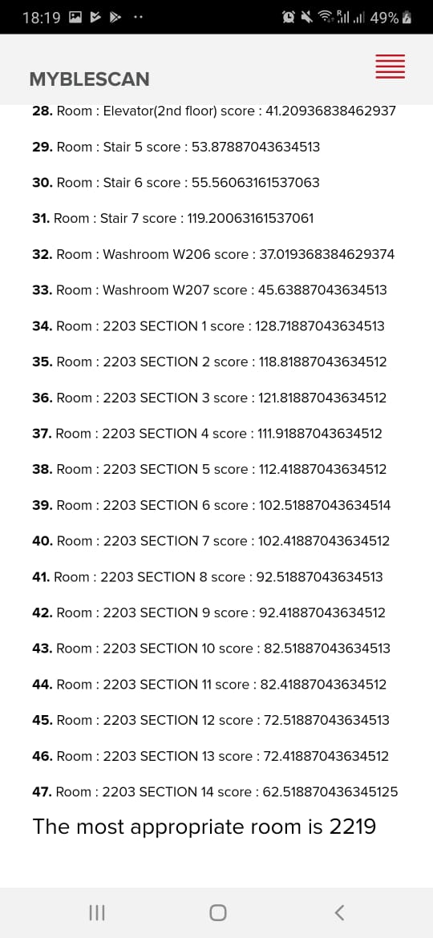
Continued from previous slide
Possible and average values of X and Y
Scores of each room

Slide 16
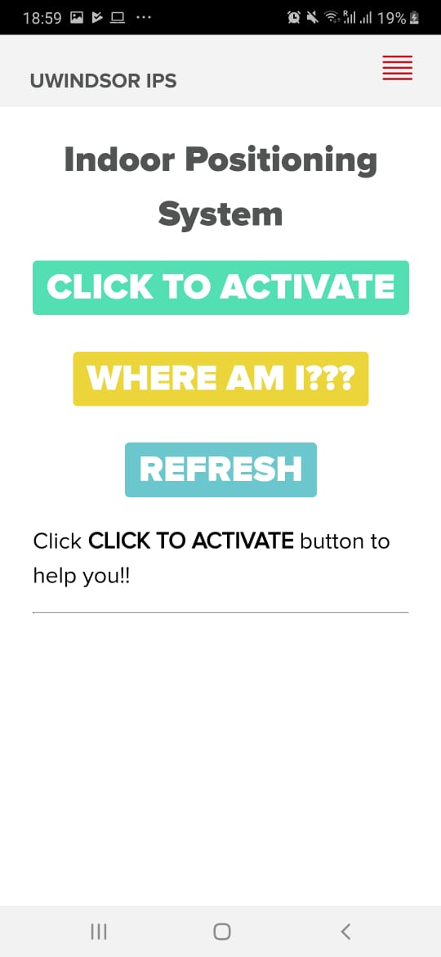
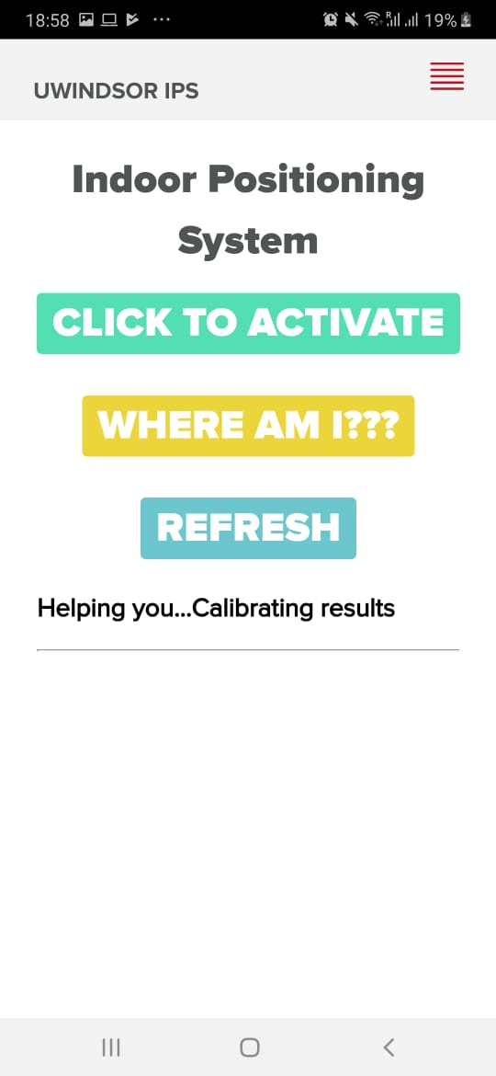
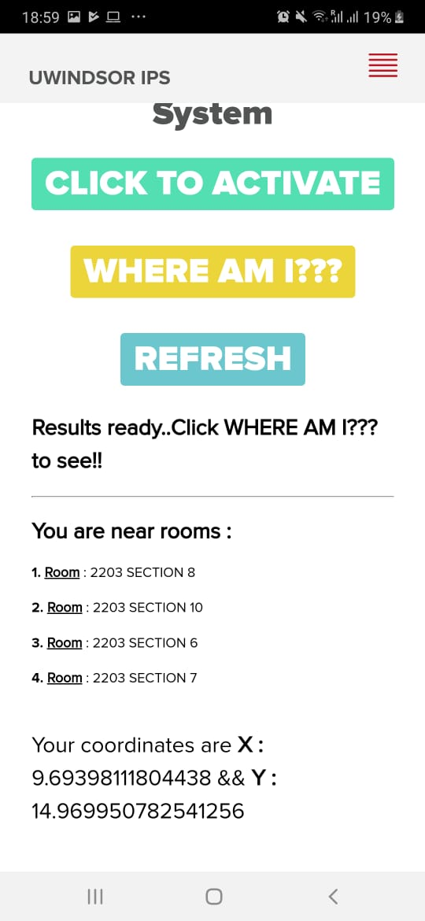
Current status:

Slide 17
Future goals
Develop the app using languages like React Native, Flutter for cross platform functionalities.
Scale the system to build IPS for entire CEI (Yes that’s possible!!).
Use better sensors for more accurate results.
Introduce more functionalities in the applications like targeted advertisements, better User Interface/User Experience (UI/UX) etc.

Slide 18
Conclusion
A cross platform mobile application was developed using Apache Cordova to give the user room level resolutions for Indoor Positioning System. It gives the user accurate results almost all of the time, but research and experiments on making the application marketable is on.

Slide 19
Important links
iBeacon Insider. WHAT IS IBEACON? A GUIDE TO BEACONS. http://www.ibeacon.com/what-is-ibeacon-a-guide-to-beacons/
Evothings website : https://evothings.com/
Evothings BLE scan github source code : https://github.com/evothings/evothings-examples/tree/master/examples/ble-scan
Javascript Map data structure link : https://flaviocopes.com/javascript-data-structures-map/
Apache Cordova website : https://cordova.apache.org/
Visual Studio website : https://visualstudio.microsoft.com/vs/

Slide 20
Acknowledgement
We would like to thank Dr. Rashid Rashidzadeh for accepting us as MITACS interns under him at the University of Windsor. We are grateful to him for the guidance he gave and the infrastructure he provided for the completion of the project.
We are also indebted to Mr. Farhan Zaki for mentoring us. Without him this project would not have seen this day. His experience and knowledge in this field is an asset to any group working to give the world a better Indoor Positioning System.

Slide 21
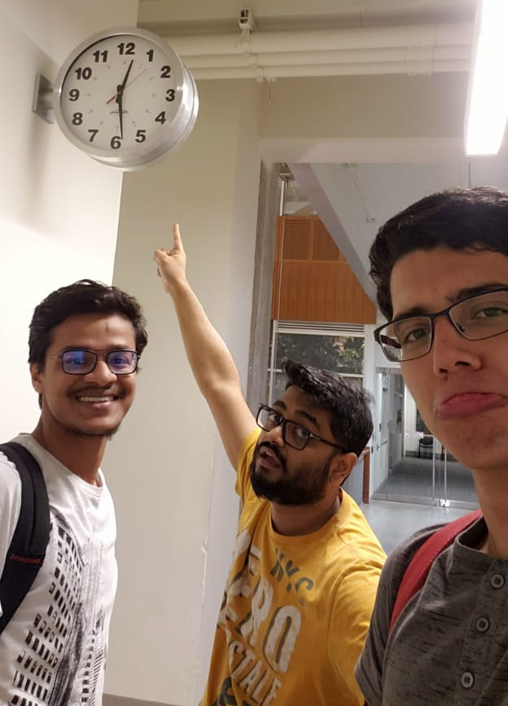
Have any questions? Shoot at us!
Sarnava Konar - konarsarnava@gmail.com
Mauricio Cisneros - mauriciocisneroscaballero@gmail.com
Farhan Zaki - zakif@uwindsor.ca

